Slide 1

Sticky Notes Project

Slide 2

Introduction
Sticky notes are vital in reminding us about our responsibilities and keeping an eye on essential tasks.
Advancement also took place in sticky notes, and now you can use them better with the help of a single online tool.
Online Sticky Notes enable you to organize tasks, set reminders and provide you with a straightforward alternative approach.

Slide 3
WHY USE ONLINE STICKY NOTES?
No Physical Limitations
Tasks should be fast to add and organize
Ability to plan your workflow
Setting priorities

Slide 4
ONLINE STICKY NOTES ADVANTAGES
Use/ See Notes From Anywhere.
Organization Is Simple
Personalize Your Notes
Notes Can Be Easily Customized

Slide 5






TECHNOLOGIES USED

Slide 6
ER-DIAGRAM
Id
title
First_Name
UserId
Target_date
Users
has a
Stickys
Last_Name
description
email
password
userId
remarks

Slide 7
FEATURES OF USER
User can Add a Sticky Note
User can Update a Sticky Note
User can Delete a Sticky Note
User can View all Sticky Notes

Slide 8
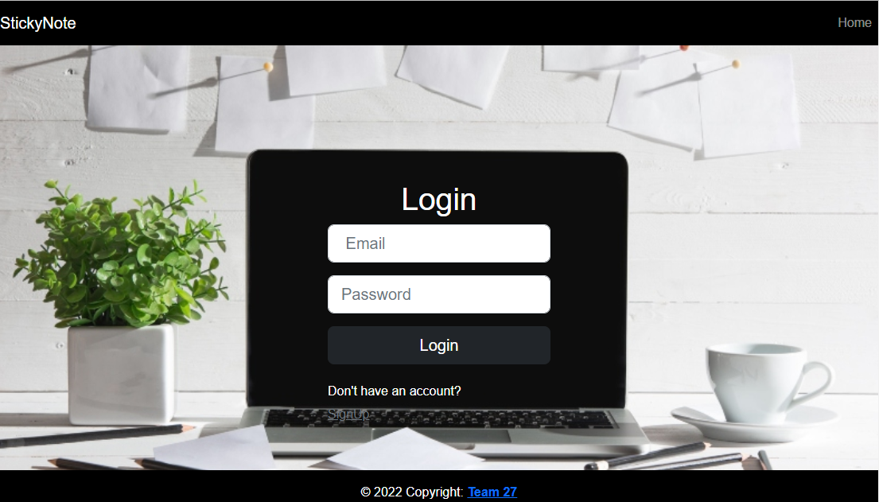
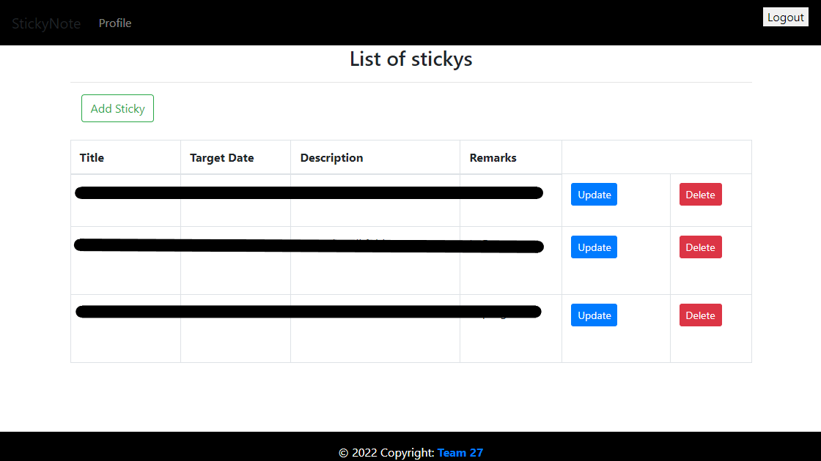
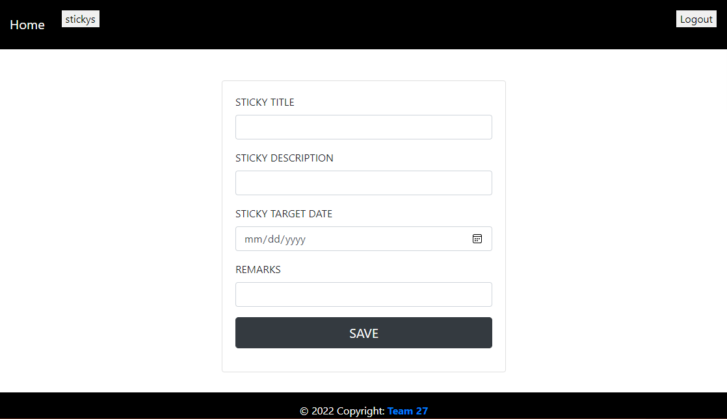
SCREENSHOTS

Slide 9
THANK YOU!!!

